Slide 1
DES Survey Update and Data Quality Overview
Shantanu Desai, Kerstin Paech, Hope Head, Joe Mohr
LMU Physics

Slide 2
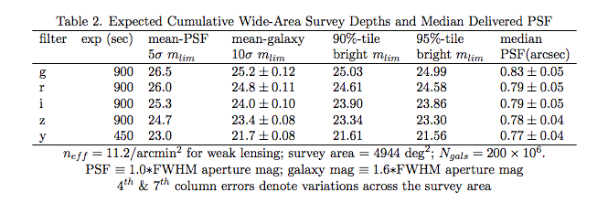
DES Survey Strategy- Depths
525 nights on Blanco 4m, Sept-Feb observing seasons
~90 sec exposures in grizY, 10 visits in each of griz
2 or 3 filters per pointing
  gr in dark time
  izY in bright/grey time
4 survey tilings/filter/year over ~half the survey region

Slide 3
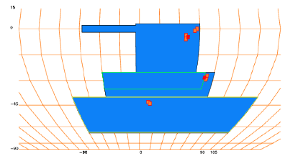

Planned DES Footprint
5000 deg² – requires ~1600 exposures for layer
10 layers in each band have significant offsets- each object observed in 10 different locations on the focal plane

Slide 4
eROSITA Sky – from Axel
Survey overlaps with eROSITA

Slide 5
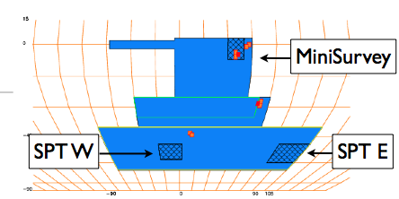
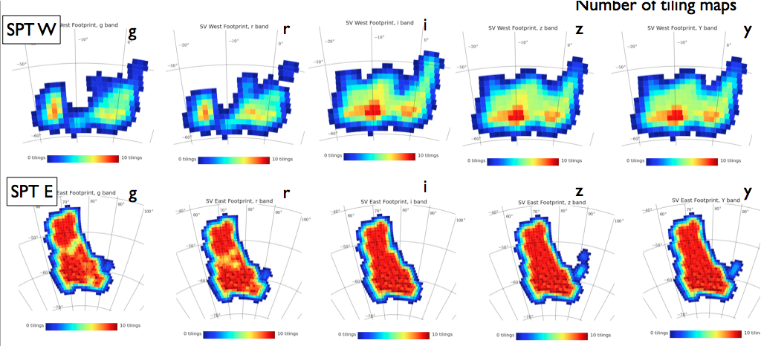

DES Science Verification
Fall 2012 observations- all data public!

Slide 6
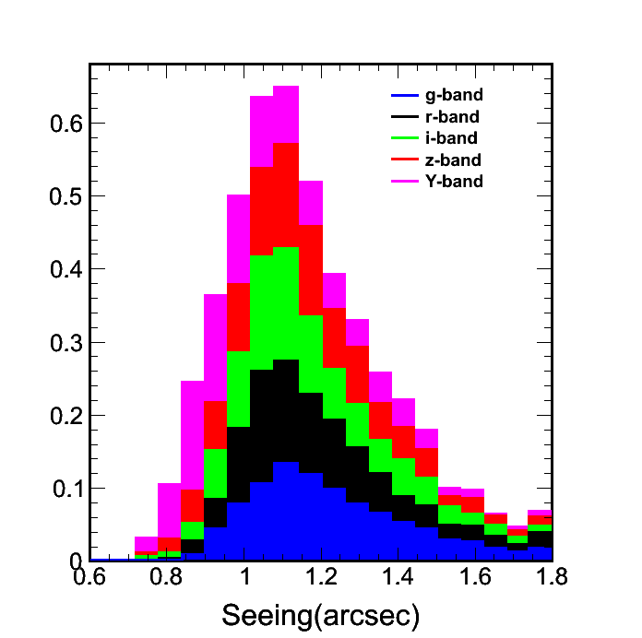
Image Quality Statistics
DES target seeing is 0.8”
SV seeing is ~1.1” (med)
  Guiding problems
  Cable wrap issue- tracking
Mirror cooling started in February, used this spring to good effect
Expectation is we can achieve <1” median
Best seeing time concentrated in wide survey

Slide 7
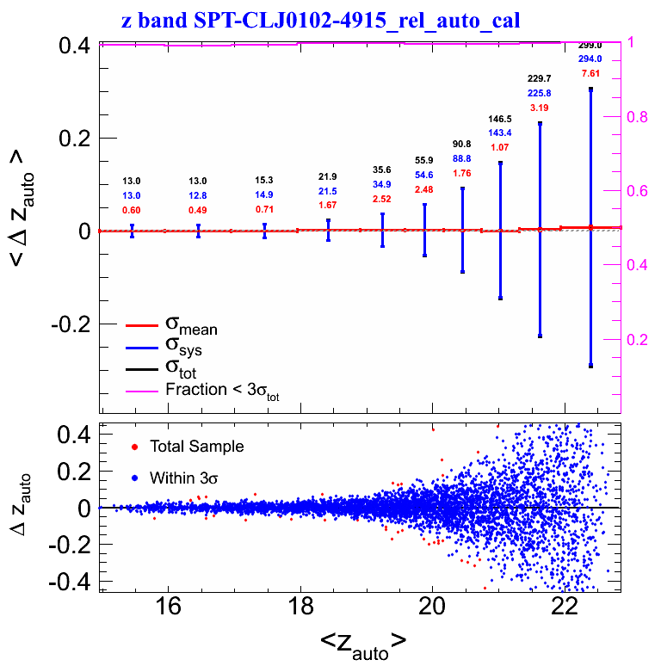
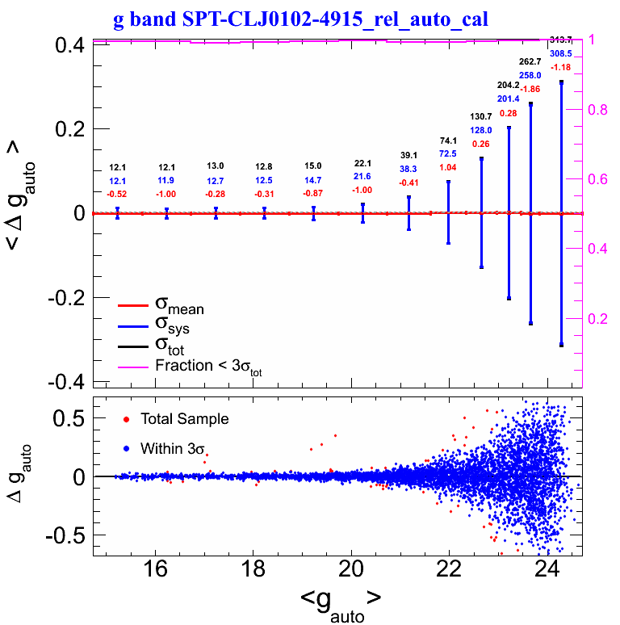
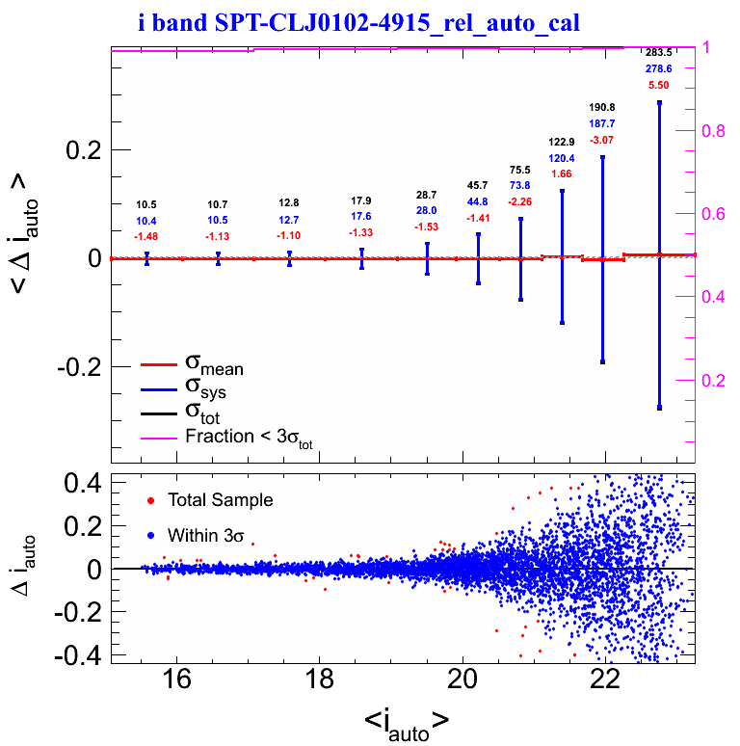
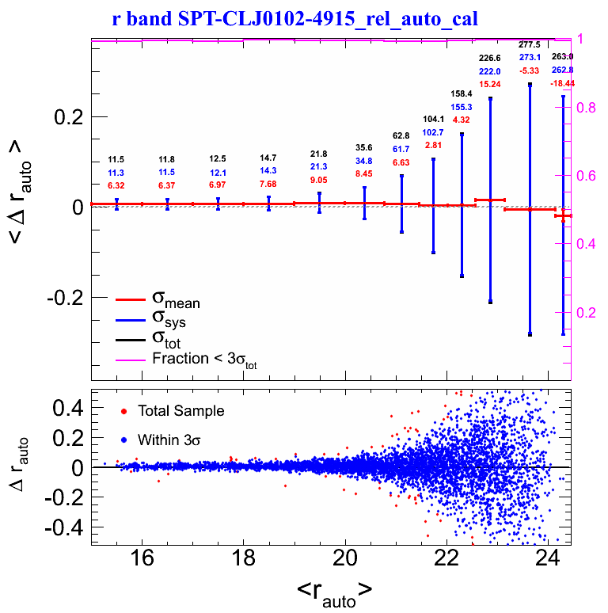
Photometric Repeatability Tests
Repeated observations of the same object in different locations on focal plane allow us to test end to end quality of photometry
Results:
  Scatter at bright end 1% to 1.5%
  E2E noise at 0.7% to 1%
Coadd scatter reduced by ~1/sqrt(10) to <0.5%

Slide 8
Zeropoint Surface Corrections
Kerstin Paech has modeled position dependent, repeatable error using hundreds of observations of Stripe 82
  Corrections at 0.5% to 0.7% level
  These corrections now applied to SPT-E and SPT-W… awaiting test results
This suggests that there is a remaining ‘random’ noise floor in our end to end system of similar scale- ~0.5%-0.7%

Slide 9
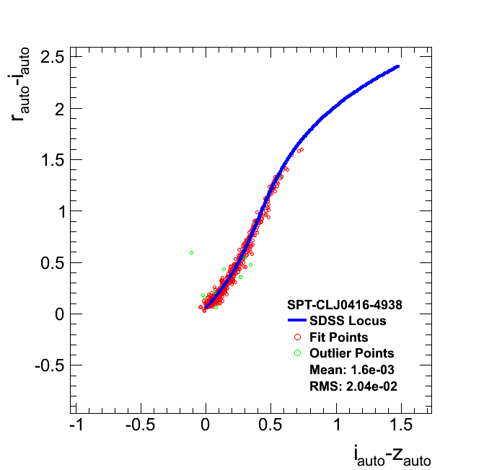
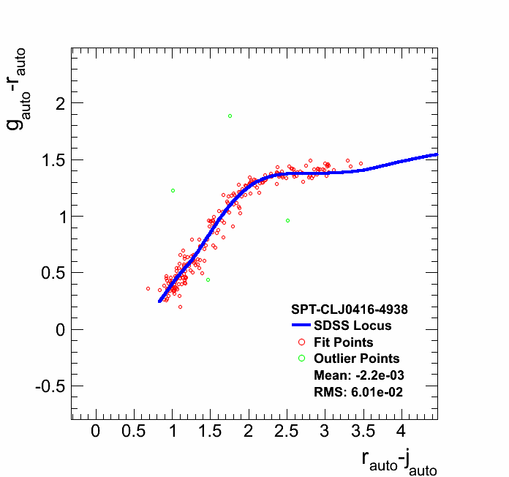
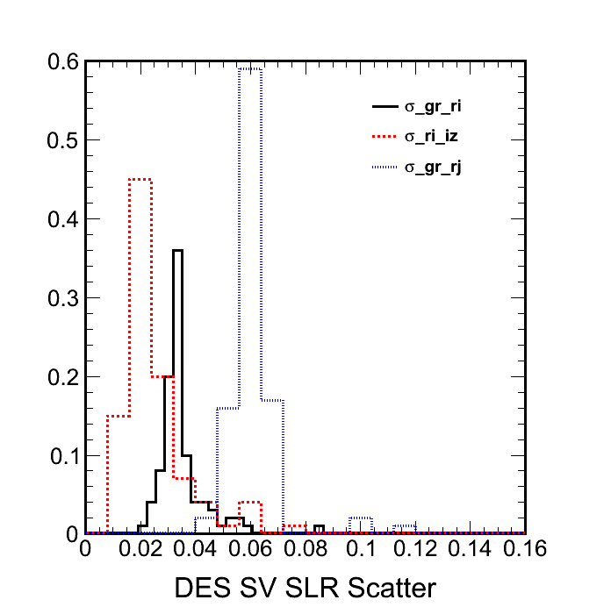
Stellar Locus Quality Tests
The main sequence populates a small region of color-color space called the stellar locus
Scatter about the stellar locus reflects the quality of the photometry
  DES: 2% to 3%
  SDSS: 4% to 5%
The location of the stellar locus along with a single absolute magnitude (i.e. from 2MASS) allows independent photometric calibration

Slide 10
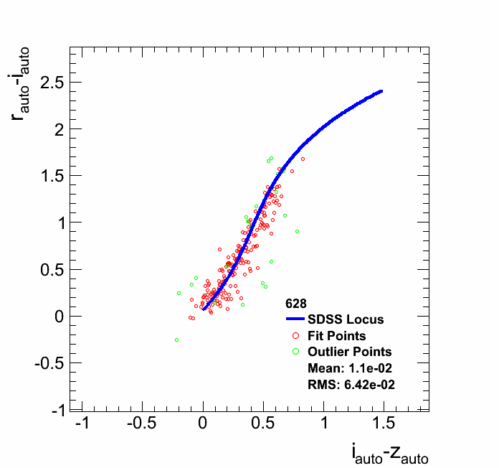
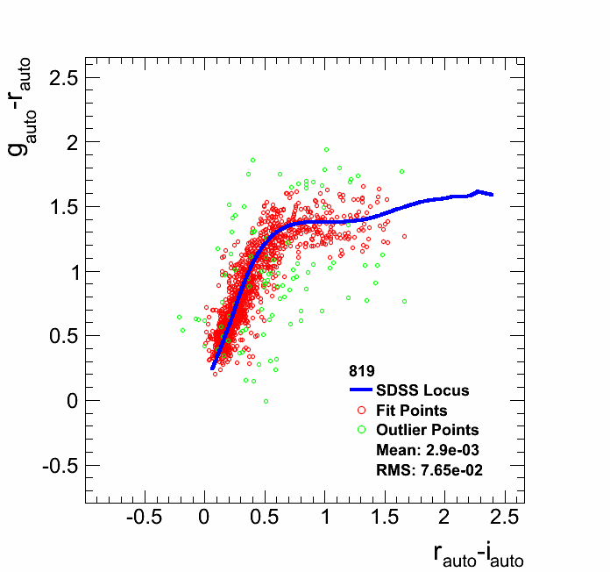
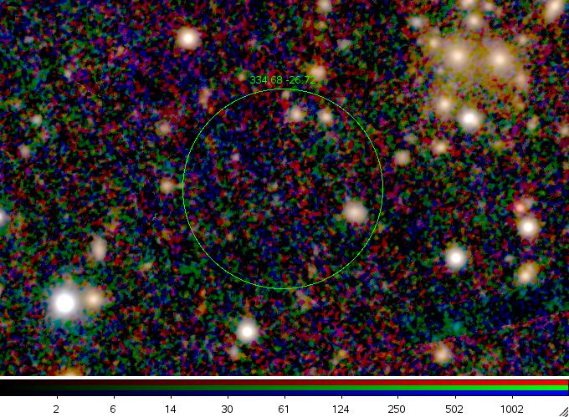
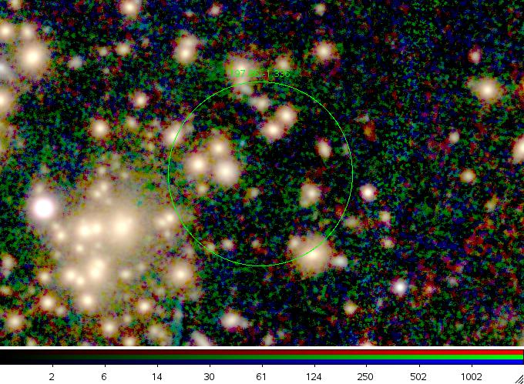
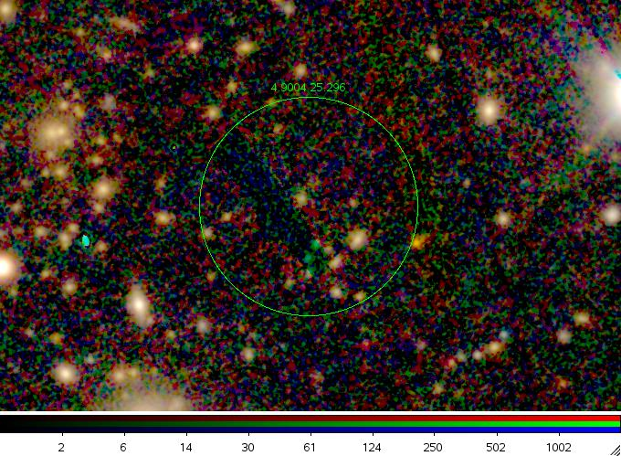
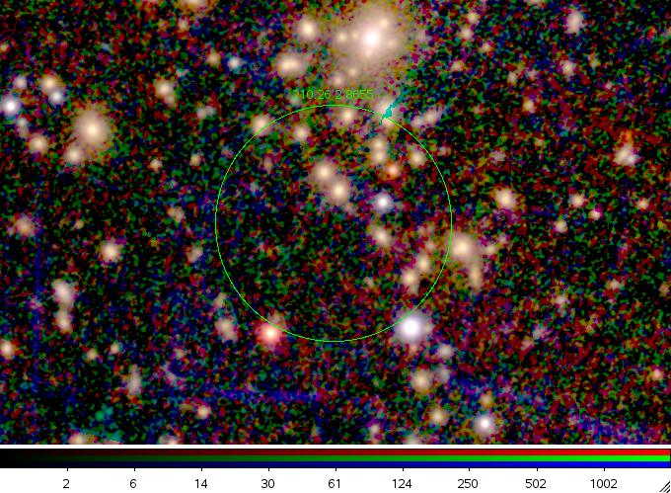
PS1 Update
PS1 3π covers everything north of -30º dec
  Think of it as a low quality SDSS survey
  ~0.5/1 mag deeper in i/z
We are using PS1 data to follow up unconfirmed Planck and XMM clusters
Two streams:
  Use existing PS1 coadds
  Build our own coadds from PS1 single epoch data
PS1 coadds:
  Calibrate using stellar locus
  Stellar locus scatter is poor: 7% typical
We are optimistic our coadds will be better, but let’s see…

Slide 12
Needed Surveys
Optical followup/photo-z’s: PS1 + DES
  Could substitute SDSS where for PS1 where available- hinges on whether our coadds are higher quality than PS1 coadds
NIR: 2MASS + VISTA
  VHS, VHS-DES, VIKING
IR: WISE + Spitzer
  Depends whether large solid angle Spitzer survey approved
Weak lensing: KIDS+DES+PS1+SDSS

